Slide 1

Finding hospitals
HACKATHON PROJECT

Slide 2
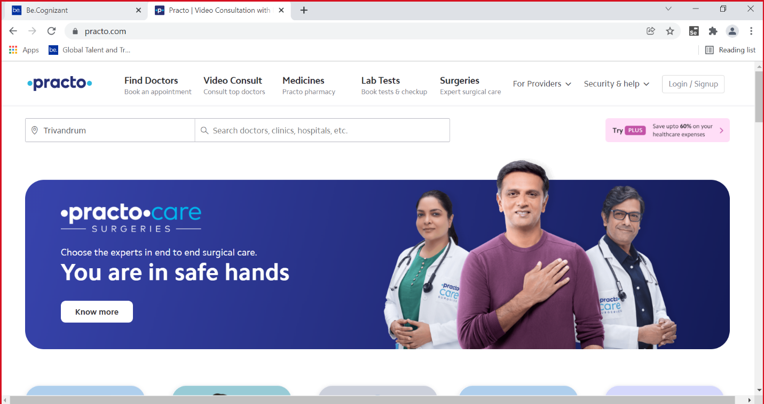
URL: https://www.practo.com/

Slide 3



About Practo
Practo is on a mission to make quality healthcare affordable and accessible for over a billion+ Indians. We believe in empowering our users with the most accurate, comprehensive, and curated information and care, enabling them to make better healthcare decisions.

Slide 4

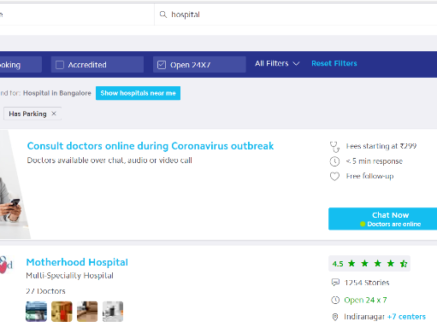
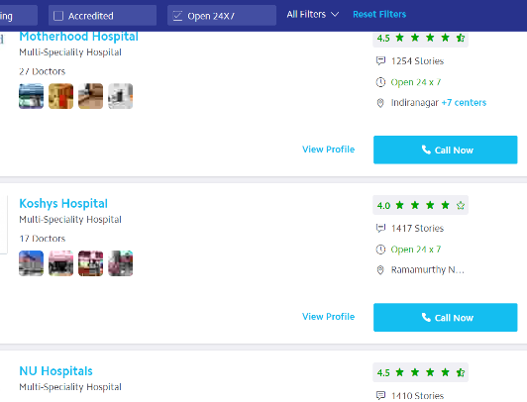

PROBLEM STATEMENT - 1
For Bangalore city, identify Hospitals that is Open 24$×$7, has Parking facility with rating more than 3.5; Display the hospital names.

Slide 5
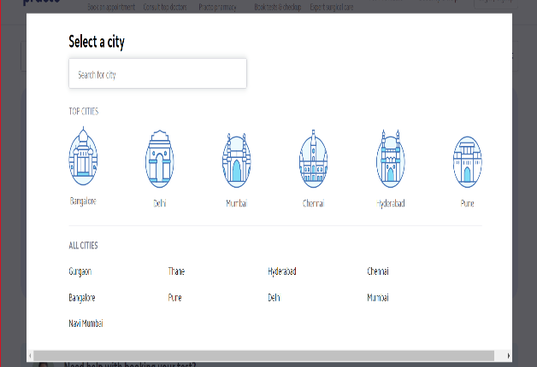
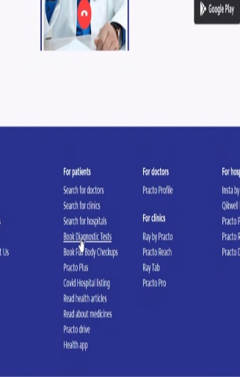
PROBLEM STATEMENT - 2
In Diagnostics page, pick all the top cities name & store in a List; Display the same.

Slide 6
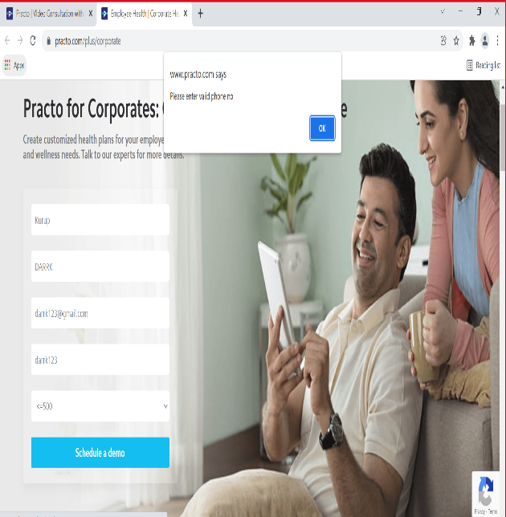
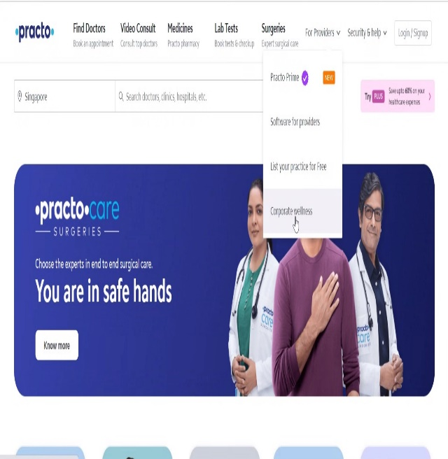
PROBLEM STATEMENT - 3
Go to Corporate Wellness, fill invalid details, schedule & capture the warning message from the alert.

Slide 7

TOOLS AND TECHNOLOGIES
Selenium Java(Version 4.1.0)
Maven
TestNG (Version 7.4.0)
Extent Reports API (Version 3.1.5)
Apache POI
POM (Page Object Model)
TestNG Reports
Jenkins
WebDriverManager

Slide 8
Manually tested the website based on the requirements
Scope
and Plan
of the Project
Efficient working of the website
Automation was carried
TestNG was invoked with smoke and Regression suites
Extent Report, Readme Documents and Power Point Presentation was done

Slide 9

Thank you
BY
TECHIE SQUAD

